Slide 1
Wednesday, November 16th
High-level Segment of COP 22|CMA1

Slide 2
What happened Yesterday?
(High-level) National Statements

Slide 3
First (of 3) day of National Statements
Who’s who of the conference hosts:
Patricia Espinosa, Executive Secretary UNFCCC
Former ambassador of Mexico to Germany
Previous experience w/Cancun & General assembly
H.E. Mr. Salaheddine Mezouar, President of COP22|CMP 12|CMA1
Minister of Foreign Affairs and Cooperation of the Kingdom of Morocco
Controversey
Former professional basketball player

Slide 4
National Statements (3 mins)
United Nations
Parties of Paris Agreement
http://unfccc.cloud.streamworld.de/webcast/un-secretary-general
https://twitter.com/COP22?ref_src=twsrc%5Egoogle%7Ctwcamp%5Eserp%7Ctwgr%5Eauthor

Slide 5
Purpose of National Statements
Remember, the honorary delegates and dignitaries are on the international stage
Put forth the pledges or intentions of their country for the negotiations
Look to the future (and apply pressure) of the conference’s outcomes. What they hope to get from it
Can you think of others? How about the U.S. at the moment?

Slide 6
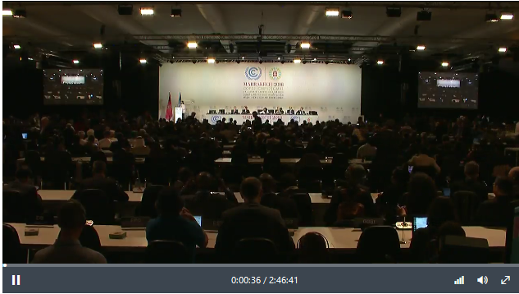
In plenary Session
First plenary meeting of the Conference of Parties of Paris Agreement
To answer yesterday’s question about how they will get started since they were not expecting the agreement to enter into force within a year or so.
http://unfccc.cloud.streamworld.de/webcast/cop-cmp-opening-plenary

Slide 7
Anticipated for Wednesday
Topic: Agriculture and Food Security

Slide 8
Side-show and Webcast
UNFCCC on Global Climate Action on Agriculture and Food Security
http://unfccc.cloud.streamworld.de/webcast/global-climate-action-on-agriculture-and-food-secu

Slide 9
High-level Statements
Group 77 and China
European Union
Alliance of Small Island States
Least Developed Countries
Independent Alliance of Latin America and Caribbean (AILAC)

Slide 10
COP22@ASU
Line-up of Events
If the UN can be the most influential participant, then HSS can win #COP22at ASU raffle
https://www.climatetalkslive.org/

