Slide 1
Tuesday, November 15th, 2016
COP22 Headlines

Slide 2
Last Week
1st Week of COP22

Slide 3
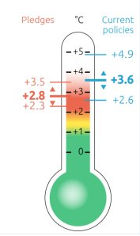
7 Highlights as seen on climatehome.com
Australia and Pakistan ratified the Paris Agreement (+27 others)
100 countries have formally joined the Paris Agreement: come into force (55% and 55 countries)
Indonesia, Brazil and Columbia took action to protect forests
Climate Action Tracker analysis of Nationally Determined Contributions (NDCs)

Slide 4
7 Highlights as seen on climatehome.com
Germany economy minister vetoed 2050 emission reduction target due to coal lobbying
The US, Canada and Mexico are all likely to release mid-century targets next week
10th Focal Point Forum of the Nairobi work programme group released a statement highlighting that: “Climate change will have a significant impact on human health by expanding the geographic range of many diseases. In addition, the impact of extreme events, both fast and slow-onset, affect human health and health infrastructure in numerous ways and on different levels.”

Slide 5
7 Highlights as seen on climatehome.com
Africa with solar power and lift its people out of poverty at the same time is not there. US$20bn before 2020 from Green Climate Fund. U.S.’s role
Moroccan and French Climate Champions Hakima El Haite and Laurence Tubiana:“80% of national climate plans have identified water as a key area for adaption”

Slide 6
Looking Forward to this week

Slide 7
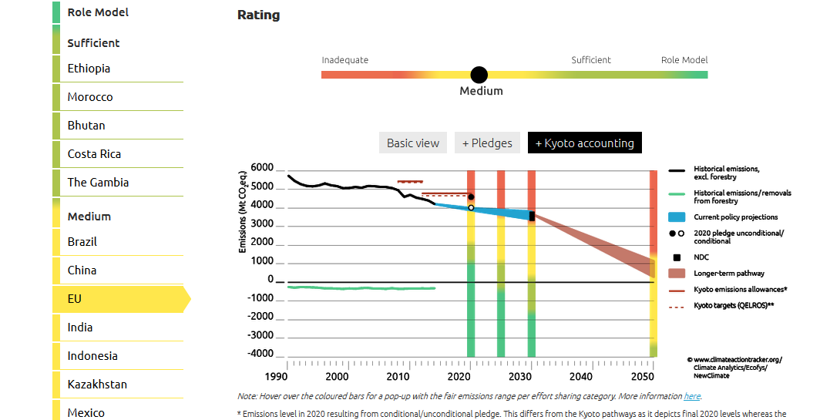
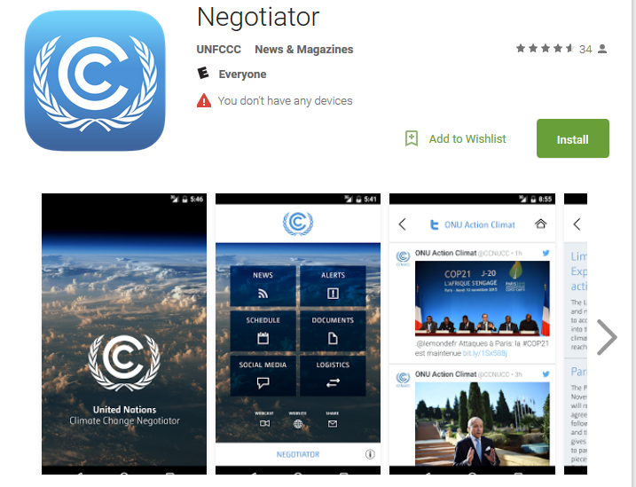
Resources to keep up…it’s a lot
https://twitter.com/climateactiontr
https://twitter.com/UNFCCC
https://play.google.com/store/apps/details?id=unfccc.negotiator

Slide 8
This Week
1st Week of CAM1

Slide 9
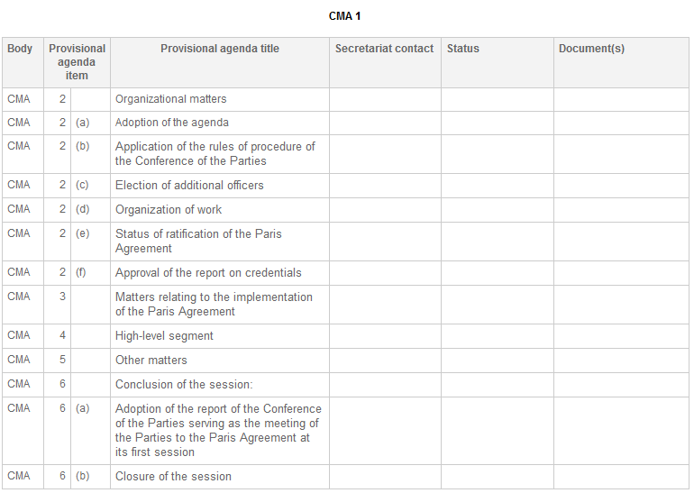
COP of Parties of Paris Agreement: cam1
Now that the Paris Agreement has entered into force, we begin the first session of the Conference of the Parties of Paris Agreement (CAM1)
About a year….no one was ready….
Work programme
Draft rules of procedures

Slide 10
High-Level Segment: THE “Fun” WEEK
Heads of State invited by His Majesty Mohammad VI
Mornings of Tuesday, Wednesday, and Thursday
3 minutes each to speak
3 pages worth of speakers
All will be on UNFCCC webpage
Begin to see coalitions
African Group
Group77
Alliance of Small Island States
Independent Alliance of Latin America and Caribbean
NGOS
http://unfccc.cloud.streamworld.de/ondemand

Slide 11
American Delegation
Secretary of Energy, Dr. Ernest Moniz
Dr. Jonathan Cooper Pershings
Special Envoy for Climate Change
Energy Department official and former State Department climate negotiator
Successor to Todd Stern
March 2016, “I don’t think any President is going to pull us out of Paris”
Will speak on Thursday
Look for strategies on Wednesday
Secretary Kerry there Tuesday, speaks Wed.
http://unfccc.cloud.streamworld.de/webcast/press-briefing-with-u-s-special-envoy-for-climate- 3:20-4:23

Slide 12
Today’s Events and #COP22aASU Raffle Winner

